Slide 1
Notes:
Introduction to the models of BGE

Slide 2
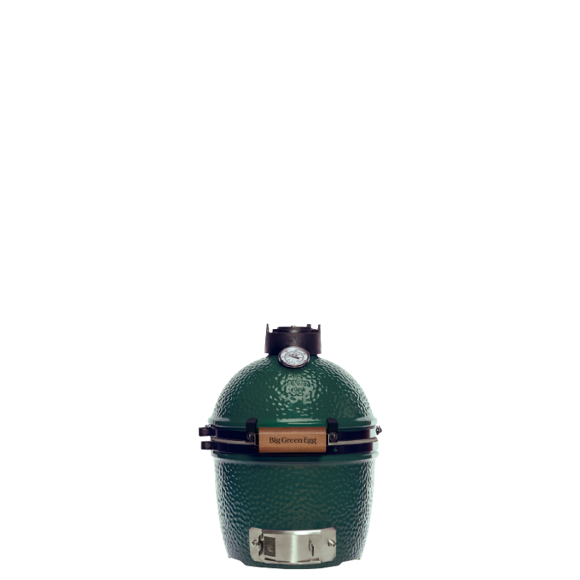
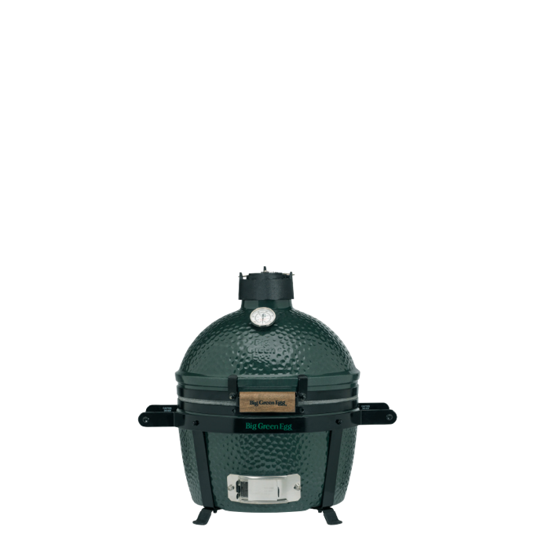
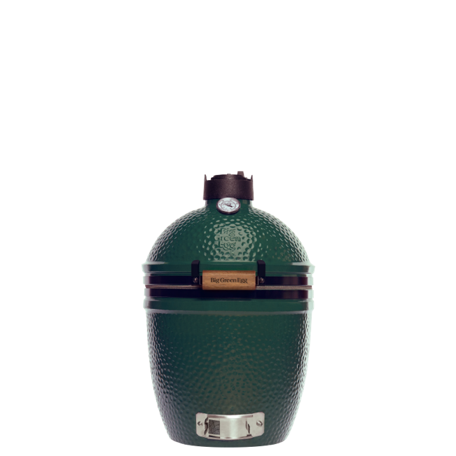
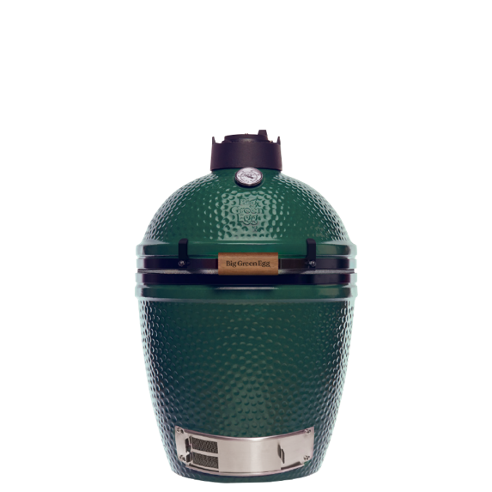
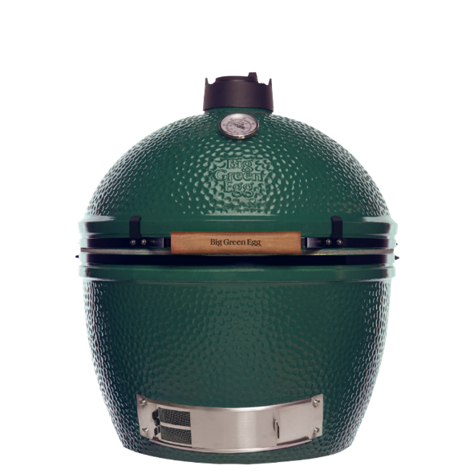
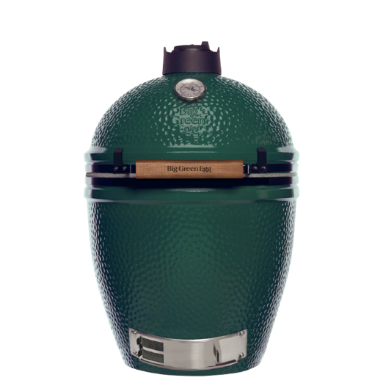
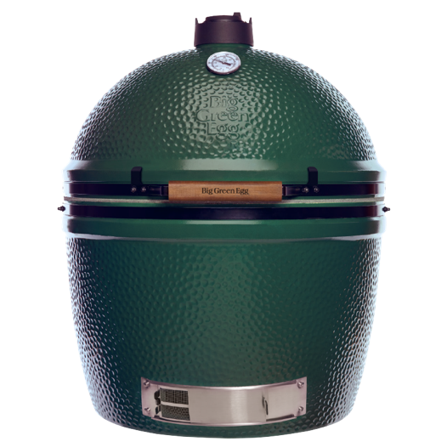
Which egg do you prefer? Big Green Egg stands alone as the most versatile barbecue and outdoor cooking product on the market, with more capabilities than all other conventional cookers combined. From appetizers to entrees to desserts, the Big Green Egg will exceed all your expectations for culinary perfection... and with seven convenient sizes to choose from, there is a Big Green Egg to fit any lifestyle!
BIG GREEN EGG OUR MODELS
Medium
The Big Green Egg Medium is compact enough that it fits a small city garden, a patio or a balcony. And yet, it is large enough to grill, smoke, stew or bake for 6 to 8 people. With a Medium in your garden, there’s nothing to stop you from inviting family or friends over to enjoy great food together. This is one of the reasons why this EGG is one of our most popular models.
The SMALL
Is outdoor cooking reserved for those with a garden? Absolutely not! The Big Green Egg Small is the perfect addition to balconies and small patios in the city. The Small may be compact, but with it, you can easily cook stellar meals for 4 to 6 people. As the grid of the Small is placed lower than that of the MiniMax, the Small is more suitable for larger preparations, even though both the Small and the MiniMax have equally sized cooking areas.
The MiniMAX
While its size may not be anything to write home about, the Big Green Egg MiniMax more than makes up for it with its performance. The MiniMax is the latest member of the Big Green Egg family and the most compact model we have. Although it’s only 7 centimetres taller than the Big Green Egg Mini, it has a far larger cooking area, which is comparable to that of the Big Green Egg Small. This gives you more than enough space to cook for 4 to 6 people. The MiniMax is an ideal table-top EGG model.
Large
The Big Green Egg Large is the most popular model of the Big Green Egg family. Its expansive cooking area makes it easy to prepare all your favourite dishes and those of your family and friends. And because the Large provides enough space to cook for 8 people simultaneously, you can cook for everyone all at once. All that available space makes it a snap to prepare full three-course menus. Install the Large in an (acacia) table or outdoor kitchen, or place the Large in an EGG Nest and Nest Handler to move it around easily and safely.
The Mini
The Big Green Egg Mini is the smallest and lightest member of the Big Green Egg family. It is ideal for camping, or to take on a boat trip or picnic. Or you could just use it at home, on your table. But let’s be frank here; once you become the proud owner of this EGG, you’ll probably want to take it everywhere you go. Thanks to its low weight, the Mini is very easy to carry. And it’s even easier to carry if you purchase an EGG Carrier for your Mini.
2Xlarge
Large, larger, largest. The Big Green Egg 2XL is the biggest member of the Big Green Egg family and the largest kamado available on the market. Everything about this model is impressive: its weight (170 kg), its size, its height (1 metre without EGG Nest) and its cooking area (more than 0,4 m2). The 2XL is an eye catcher in each and every way, and it delivers a performance to match. Add an EGG Nest and a Nest Handler, and the 2XL can be easily moved from one spot to another. In addition, its clever hinge mechanism makes it possible to open this EGG with ease.
Xlarge
Do you have a big family and/or group of friends? Do you cook professionally? Or do you like to cater for large groups? If any of the above applies to you, then the Big Green Egg XLarge is your perfect partner in crime. As this multi-tasker has a grid that is more than 30% larger than that of the Large, it enables you to serve deliciously cooked ingredients and dishes to loads of people simultaneously. With the XLarge’s 61 cm diameter cooking area, big chunks of meat, fish or several pizzas at a time are not a pipe dream, but a reality.

Slide 3
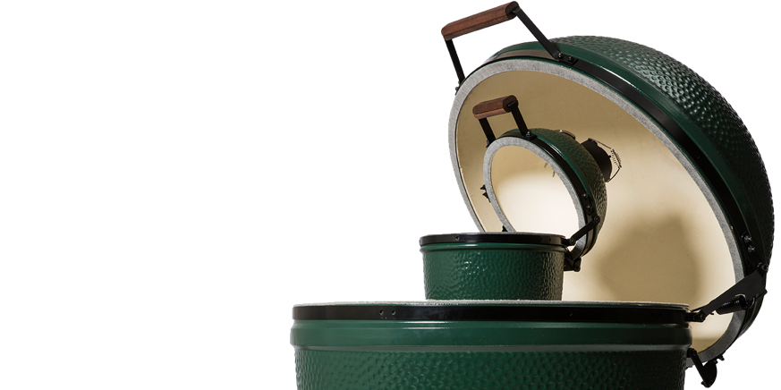
BIG GREEN EGG Sustainability
 SUSTAINABLE MATERIALS
Big Green Egg® aspires to produce its products from sustainable materials. For example, our natural lump charcoal is made from waste wood from the lumber industry which conserves wood resources, and the charcoal is produced in modern, efficient and non-polluting charcoal kilns.
 LIMITED LIFETIME WARRANTY
Because each Big Green Egg® will last for at least a lifetime, we offer a limited lifetime warranty. This makes it possible for you to endlessly enjoy cooking ingredients and dishes in a healthy way with exceptionally tasty results.
ECONOMICAL
The EGG’s structure and the materials used, makes Big Green Egg® combined with top-quality Premium Lump Charcoal highly economical. What’s more, the charcoal generates surprisingly little ash.
OLD WISDOM, NEW TECHNOLOGIES
Enjoy the Big Green Egg® and open your world of culinary possibilities. Let your creativity run wild. But most of all, let life taste good.

Slide 4
Notes:
Ending slide. Do not press next after this slide then the screen will go black. Leave this slide on when people leave the room.

Slide 5
BIG GREEN EGG Explained
CERAMIC SNUFFER CAP
Add the ceramic cap after cooking to extinguish heat and reuse the remaining charcoal next time. Leave in place when the EGG® is not in use.
DUAL FUNCTION METAL TOP
Adjust two ways, to regulate airflow and precisely control temperature.
TEMPERATURE GAUGE
Gives precise internal temperature readings. Monitor cooking progress without opening the EGG®.
LID WITH CHIMNEY
Ceramic dome with chimney that can be opened and closed easily because of the spring mechanism. The ceramic material features a protective glaze. The insulating, heat retaining properties of the ceramic material create an air flow within the EGG®, ensuring that dishes are cooked evenly and tastefully.
A UNIQUE COOKING SYSTEM
Made from ceramic technology, advanced by NASA, it creates a unique cooking system that brings out the unrivalled mouthwatering flavours while cooking, baking, grilling, stewing, smoking your favorite recipes.
STAINLESS STEEL GRID
The Stainless Steel Grid is used as the primary cooking surface for grilling or roasting.
FIRE RING
Stacks on top of the Fire Box, providing the shelf for the convEGGtor® and cooking grids.
GRATE
Sits inside the Fire Box. Perforated to allow airflow up through the EGG® and any ash to drop down, for easy removal after cooking.
DRAFT DOOR
Works in combination with the dual function top, regulating the inbound air supply to control temperature. Also enables easy removal of ash.
BASE
Heavy duty insulated ceramics. Chip and fade resistant glaze.
CERAMIC FIREBOX
The fire grate rests in the ceramic base and must be filled with charcoal. Since the grate is equipped with sophisticated openings and works with the vents at the bottom of the EGG®, the air flow is constant and optimal when the dual-function metal top and draft door are open.
Notes:
See hand out for model parts

Slide 6
Notes:
Ending slide. Do not press next after this slide then the screen will go black. Leave this slide on when people leave the room.

Slide 7
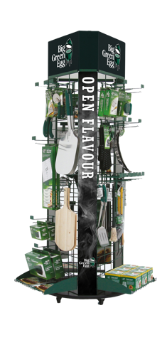
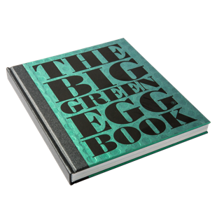
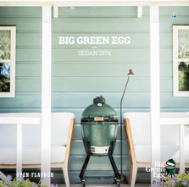
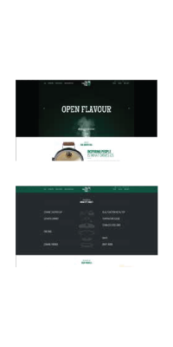
BIG GREEN EGG Marketing & POS
Catalogue
A premium full colour catalogue which contains the complete product range of Big Green Eggs and Big Green Egg accessories. The catalogue can be used during the sales process between a reseller and the end user.
Enjoy!
A two-yearly newspaper full of inspirational information. Big Green Egg goes on tour throughout Europe to find the best products nature has to offer. Exploring the ‘Chefs Backyard’ and prepare their favorite recipes together on the Big Green Egg. It can be used to build relation- ships with consumers.
Instore Communication
Big Green Egg has a wide variety of POS material available, in order to inform the customers. Custom build area’s are available upon request.
BGE Book
Foodies love to read cookbooks in their spare time. This premium book is a valuable addition to the already wide product range of Big Green Egg. The Big Green Egg Book contains a lot of information and recipes.
Online Platform
With the website and social media channels Big Green Egg has a strong online platform. When people are engaged, Big Green Egg is their preferred buying choice. They’re loyal and they become advocates for the brand. Within their own network but especially with social media, blogs and forums.
Notes:
See handout out for explanation.

