Slide 1
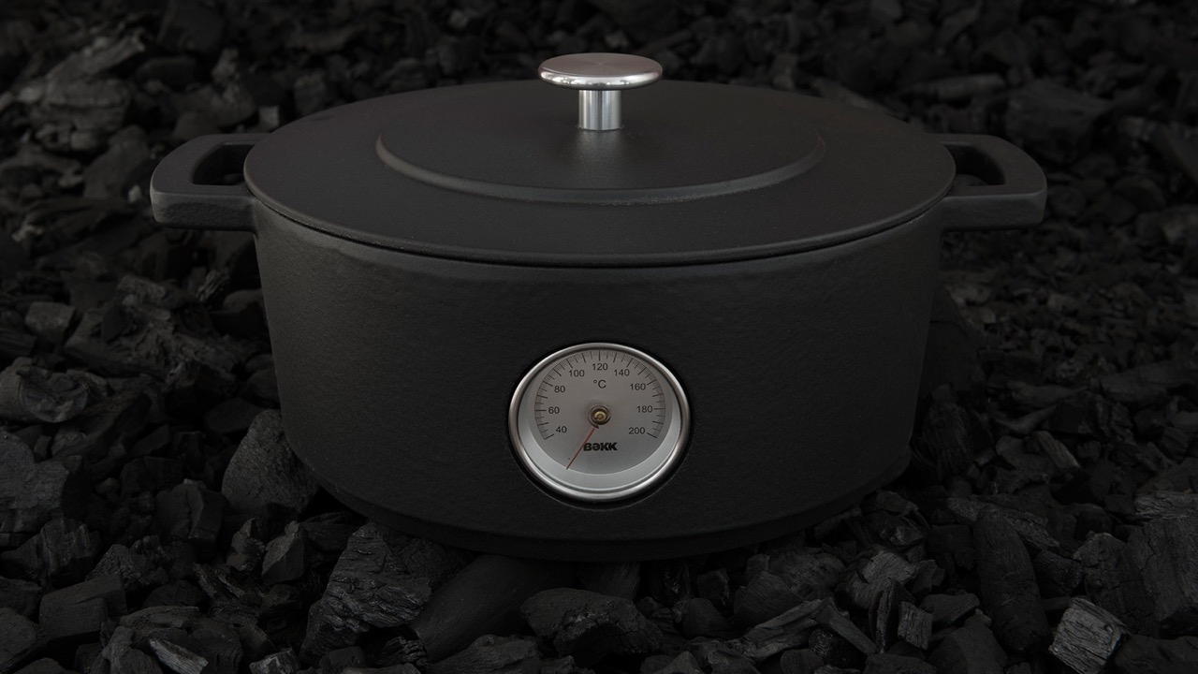
COMBEKK
QUALITY CAST
IRON

Slide 2
COMBEKK STEEL WITH A STORY

Slide 3
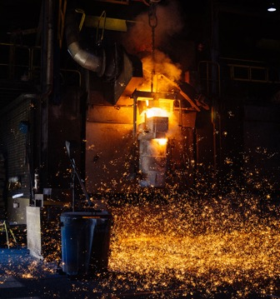
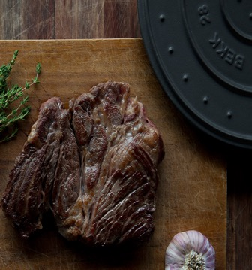
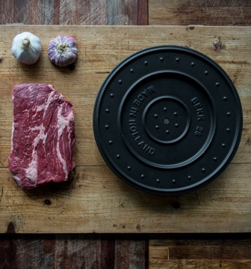
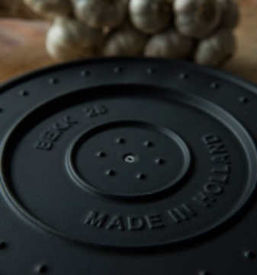
DUTCH OVEN
A “Dutch Oven” is known all over the world. The name refers to a production technique, which is invented in The Netherlands. We are very proud that we are the only brand producing all our Dutch Ovens in The Netherlands, like it should be!

Slide 4
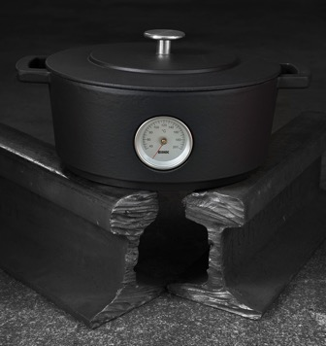
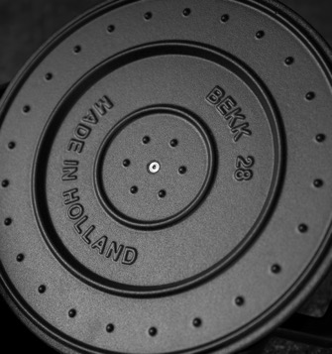
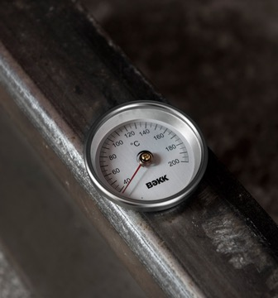
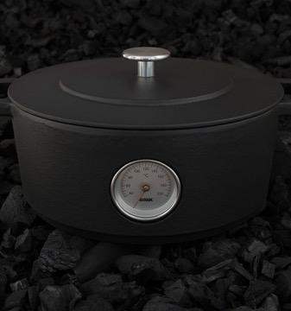
RAILS EDITION
The very first Combekk pans tell the story of Dutch railways. The bottom of each Combekk Rails Edition pan bears a stamp that refers to its origin. Our fully enamelled cast iron products are made entirely from recycled materials with a tough and functional design. The special forge and the right mix of materials make Combekk pans of the highest quality.

Slide 5
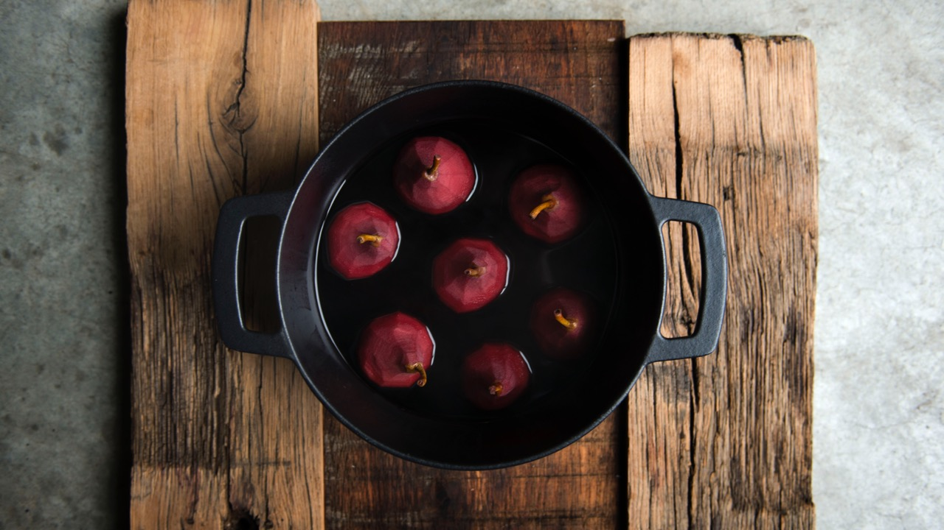

Slide 6
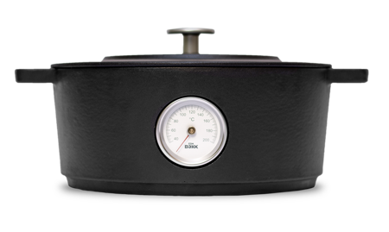
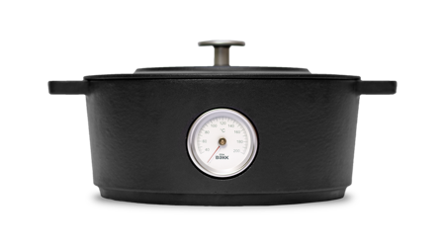
COMBEKK
DUTCH OVEN 28CM
100128DG THERMOMETER – DARK GREY
COMBEKK
DUTCH OVEN 24CM
100124DG THERMOMETER – DARK GREY

Slide 7
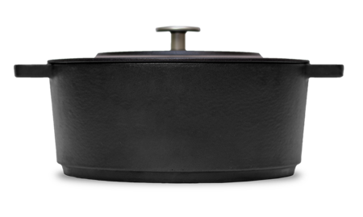
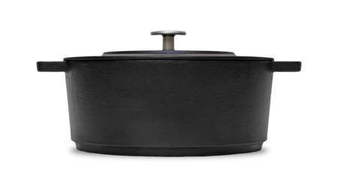
COMBEKK
DUTCH OVEN 28CM
100128DG – DARK GREY
COMBEKK
DUTCH OVEN 24CM
100124DG – DARK GREY

Slide 8
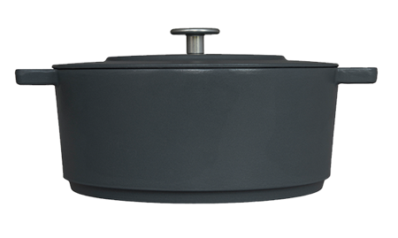
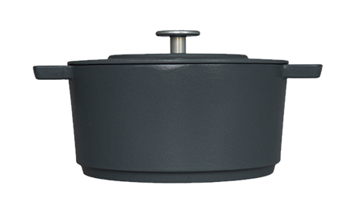
COMBEKK
DUTCH OVEN 28CM
100128CC THERMOMETER – CONCRETE
COMBEKK
DUTCH OVEN 24CM
100124CC THERMOMETER – CONCRETE

Slide 9
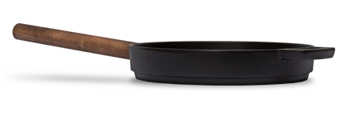
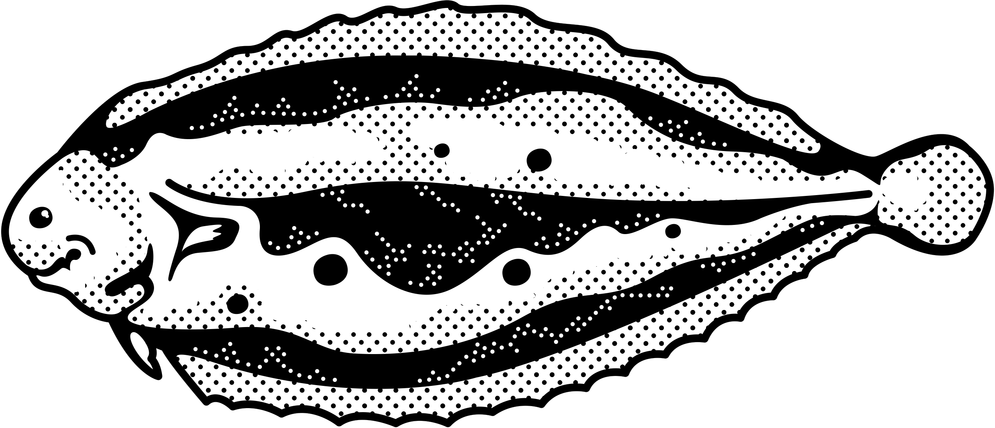
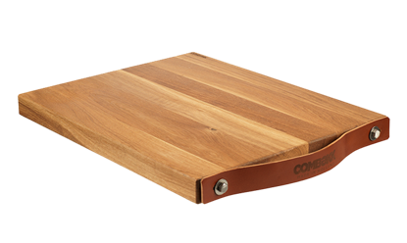
COMBEKK
FRY PAN 28CM
1001128DG
COMBEKK
CUTTING BOARDS
500304 40x49x4cm
500303 30x40x4cm
500302 30x40x3cm

Slide 10
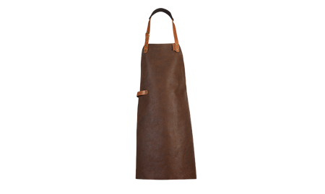
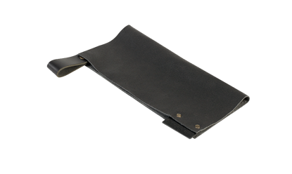
COMBEKK
LEATHER APRONS
500113 – Rust
500112 – Brown
500111 – Black
COMBEKK POT HOLDER LEATHER
500102 Set of 2 Black
500103 Set of 2 Brown
500104 Set of 2 Rust

Slide 11
